Slide 1





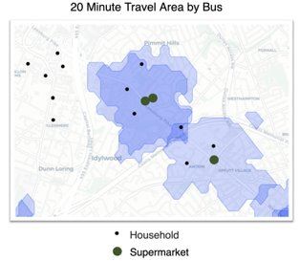
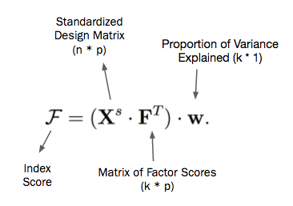
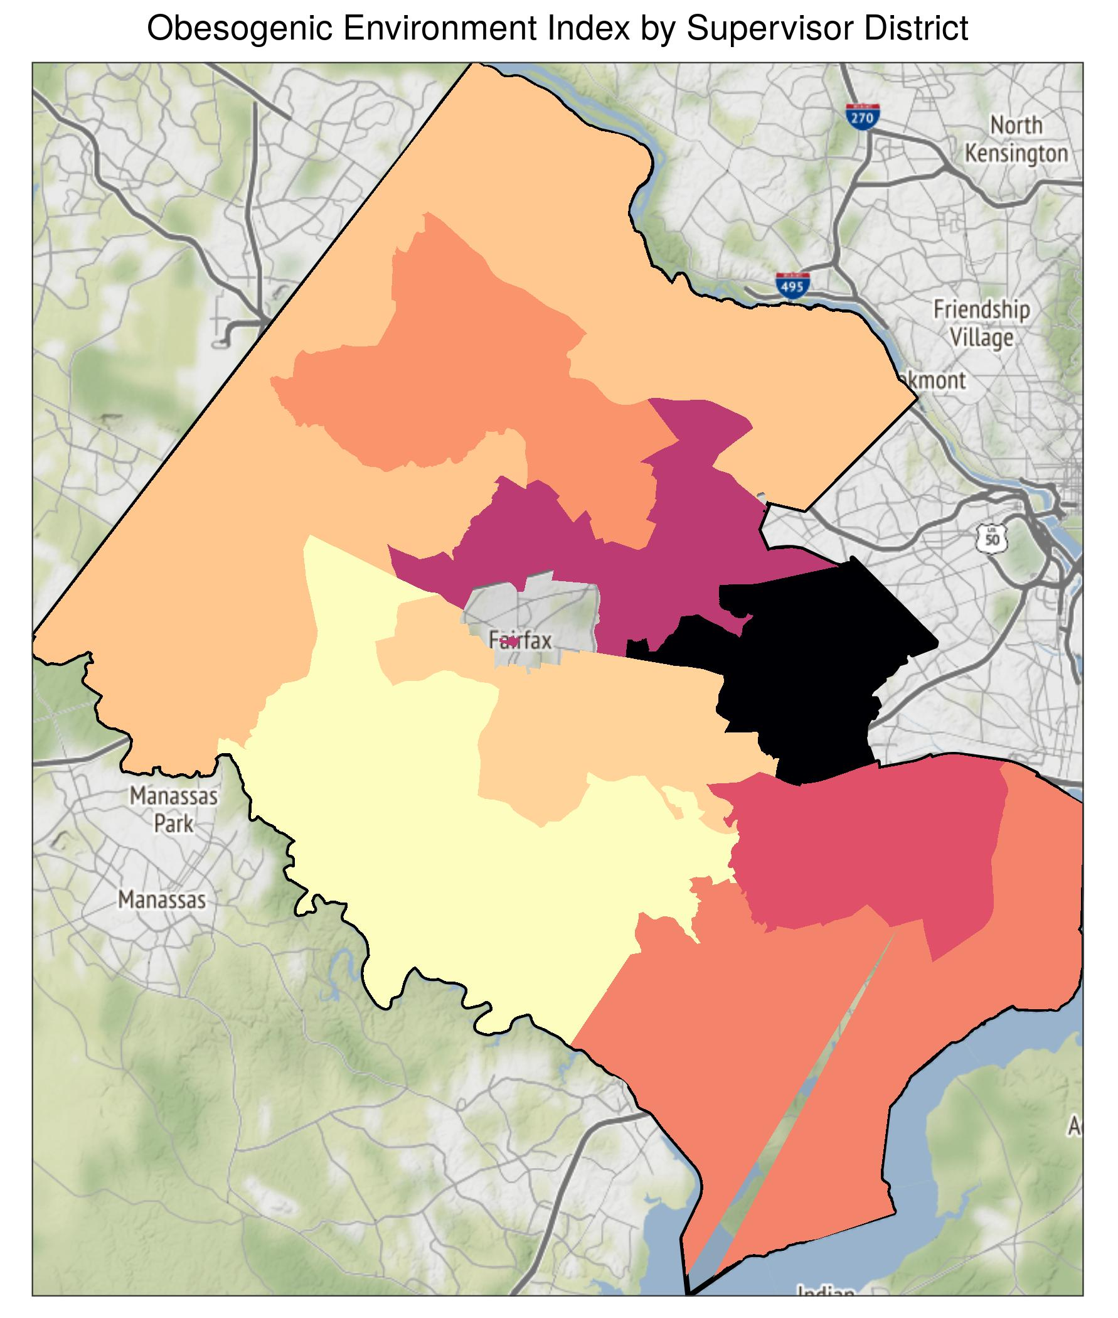
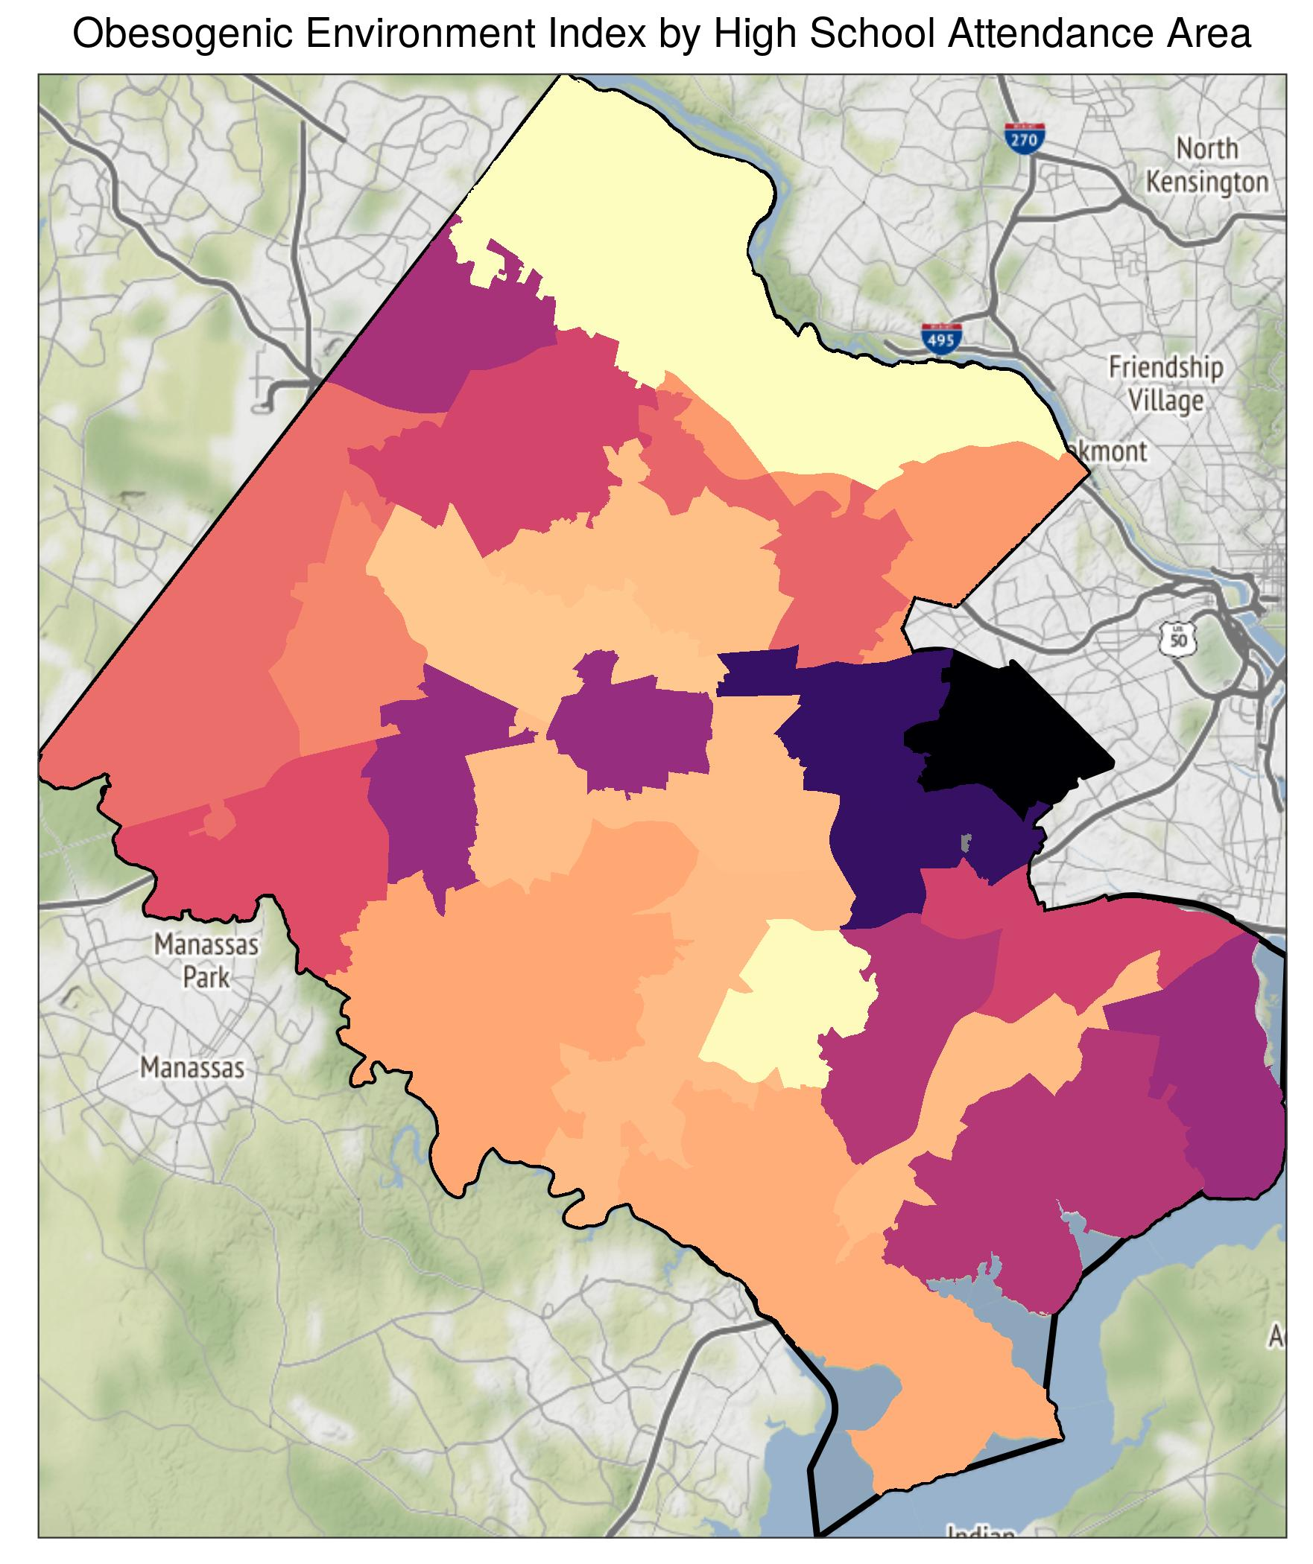
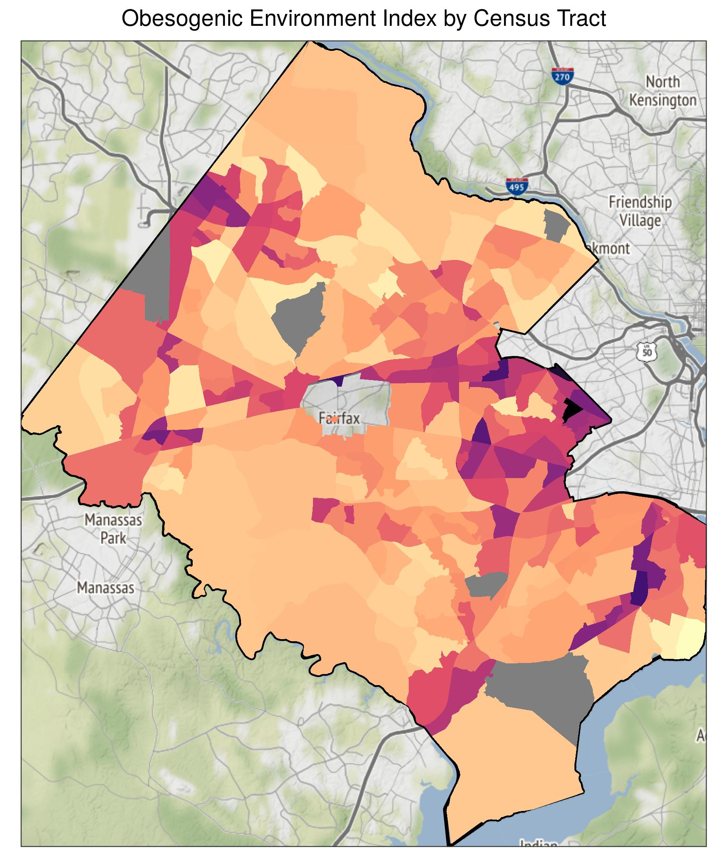


FAIRFAX COUNTY COMMUNITYSCAPE:
OBESOGENIC ENVIRONMENTS
DSPG Team: Cong Cong and Victoria Halewicz (University of Illinois at Urbana-Champaign), Quinton Neville (Columbia University), Eliza Tobin (University of Virginia)
SDAD Team: Teja Pristavec, Josh Goldstein, Brandon Kramer, Joy Tobin
Sponsor: Fairfax County and INOVA
Project Introduction
Obesogenic Environment
“The sum of influences that”
the social determinants of health have on promoting obesity in individuals or populations.” (Swinburn et al. 1999)
Framework
Fairfax County and Inova Health System would like to identify where obesity risk factors for vulnerable populations are high, offering health officials and policymakers an actionable resource to inform policy.
Composite Index
SES
Explaining unobservable factors
with measurable variables
Objective: Create an obesogenic index to measure obesity risk quantitatively in Fairfax County and establish a baseline for measuring change.
Measurable Variables
Food
Obesogenic Environment
Phys.
Data Sources
Methods
OpenStreetMap (OSM): Geospatial locations of physical features
Variable Construction
Factor Analysis
Index Construction
American Community Survey (ACS): Demographics, Financial Conditions, Employment Status, Transportation, Synthetic Population.
1. ACS & Fairfax variable exploration → selection
2. ​Distance-time mutation from OSM data and travel-time isochrones
Restaurants
1. Standardize features
2. Factor loading weights
3. Proportions variance weights
4. Weighted sum score
5. Normalize score scale (0, 1)
Fast Food
0.8
0.9
Dimension 1:
Food Environment
Cronbach’s Alpha: 0.92
Gas Stations
0.7
0.8
Supermarkets
0.7
0.6
Alcohol Stores
Convenience Stores
Fairfax County Housing Stock: Domicile Locations​,
Housing Conditions​
Hispanic
No Insurance
Dimension 2: Social and Economic Status
Cronbach’s Alpha: 0.89
No High School
0.9
0.9
0.7
0.9
Poverty
0.5
Results
Black
Data Analysis
No Team Sport
Regions at high risk (darker color) of exposure to obesogenic environments:
Supervisor Districts: Mason, Providence, Lee.
High School Districts: Justice, Annandale, Falls Church.
Census Tracts: Arlington and Dulles Airport adjacent.
No Swimming Pool
0.8
Dimension 3: Physical Environment
Cronbach’s Alpha: 0.82
0.7
No Playground
0.7
Obesogenic Environments
Supervisor Districts
High School Districts
Census Tracts
Obesogenic environment exposure
Low
High
Limitations
Conclusions
Next Steps
Quality of OSM data
Quality of TravelTime application programming interface (API)
Index weights and validation
Interdisciplinary method for index construction provides new measurement for health inequities
Low-income racial and ethnic minority groups have high risk, especially Hispanics
Policy intervention and resource allocation requires analysis at multiple geographic units
Overlaying findings with Inova health data to better understand patient population
Conduct sensitivity analysis (robustness of index)
Compare current policy initiatives with maps to enhance existing measures and to create evidence-based policy
Resources
Centers for Disease Control and Prevention (2019). Social determinants of health. Available at https://www.cdc.gov/socialdeterminants/index.htm (7/31/2019).​
Swinburn, B., Egger, G., & Raza, F. (1999). Dissecting Obesogenic Environments: The Development and Application of a Framework for Identifying and Prioritizing Environmental Interventions for Obesity. Preventive Medicine, 29, 563-70. doi:10.1006/pmed.1999.0585​
Notes:
\item Standardize the variables
\item Take a weighted sum at each geographic observational unit for each Factor (where the weights are coming from the loadings in our factor analysis model) to obtain each Factor score.
\item Take a weighted sum of the Factor scores (where the weights are coming from the proportion of variance explained by each factor).
\item Normalize the results to a consistent (0, 1) scale.

